Slide 1


Scientific Writing
DEPH 312 Principles of Scientific Evidence
Talal Alshihayb ^{BDS, DScD}
Diplomate, American Board of Dental Public Health
Assistant Professor
Department of Preventive Dental Science, College of Dentistry, King Saud bin Abdulaziz University for Health Sciences
Department of Health Policy and Health Services Research, Henry M. Goldman School of Dental Medicine, Boston University
February 1, 2024
shihaybt@ksau-hs.edu.sa

Slide 2
Recap
Study tasks
Measures of disease occurrence
Measures of association
Study designs
Validity and precision
Random and systematic errors in research
Causality and causal effects
Variables and their description
Measures of central tendency and dispersion
Types of distributions and the theoretical distribution
Inferential statistics (p-values and confidence intervals)
Sampling
Evaluation of primary studies

Slide 3

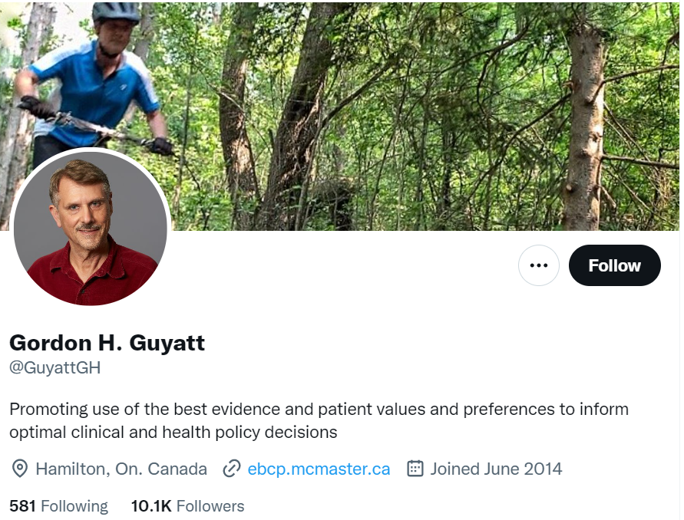
What is evidence based dentistry?
“Doing the right thing, for the right patient, at the right time”
“The conscientious, explicit, and judicious use of current best evidence in making decisions about the care of individual patients. The practice of evidence-based medicine means integrating individual clinical expertise with the best available external clinical evidence from systematic research”
Sackett D.L.S.S., Richardson W.S., Rosenberg W., Haynes R.B. Evidence-Based Medicine: How to Practice and Teach EBM. 2nd ed. Edinburgh: Churchill Livingstone; 2000.

Slide 4
Components of Evidence based dentistry
Scientific basis (research)
Clinical expertise (clinician)
Patient’s value (patient)

Slide 5
Evidence based dentistry
Assemble evidence
Evaluate evidence
Summarize evidence

Slide 6
Evidence based dentistry
Narrative
Unstructured search of the literature
Informal
Subjective evaluation
Often based on the opinion of the author/s of the review
Systematic
Structured search of the literature
Formal
Objective evaluation (however this is often violated)
May include quantitative analysis (summary)

Slide 7
Systematic reviews
Start with a research question (PICOT)
The research questions guides the search strategy
Screen the papers and apply inclusion/exclusion criteria
Appraise the included papers based on tools (e.g., ROB 2, ROBIN-E, ROBIN-I, STROBE, CASP, etc.)
Report based on (PRISMA: Preferred Reporting Items for Systematic reviews and Meta-analysis)

Slide 8
Meta-analysis
Quantitative analysis of the results of previous studies (not their raw data)
Idea is to combine results from different studies to get a single estimate in hope to investigate:
Differences between them
Increase the sample size

Slide 9
LECTURE LEARNING OUTCOMES OF EACH OF THE DIDACTIC SESSIONS
REFERENCE: Handout.
LECTURE LEARNING OUTCOMES:
Describe scientific writing.
Describe the different components of a research paper.

Slide 10
What is scientific writing?
Writing to communicate your research

Slide 11
Writing a research paper
Early draft (outline of manuscript)
Begin writing even if ideas are not fully formed
Rothman KJ. Writing for epidemiology. Epidemiology. 1998 May 1;9(3):333-7.

Slide 12
Feedback on your writing
The published paper usually goes through multiple rounds of revision
You should evaluate your work
Send to others for a read
Colleagues
Coauthors
Supervisors
“What question will occur to the reader at this point?”
Requires you to know your audience (scientific, general public, etc.)
“Do not assume that readers know about your topic than they actually do”
The better you explain, the wider your audience
Keep your feelings away (do not take it personal)
Keep it brief
Journals have limits on number of words
Rothman KJ. Writing for epidemiology. Epidemiology. 1998 May 1;9(3):333-7.

Slide 13
Grammar and style
Avoid
Technical jargon
Passive voice
Excessive use of abbreviations
Rothman KJ. Writing for epidemiology. Epidemiology. 1998 May 1;9(3):333-7.

Slide 14
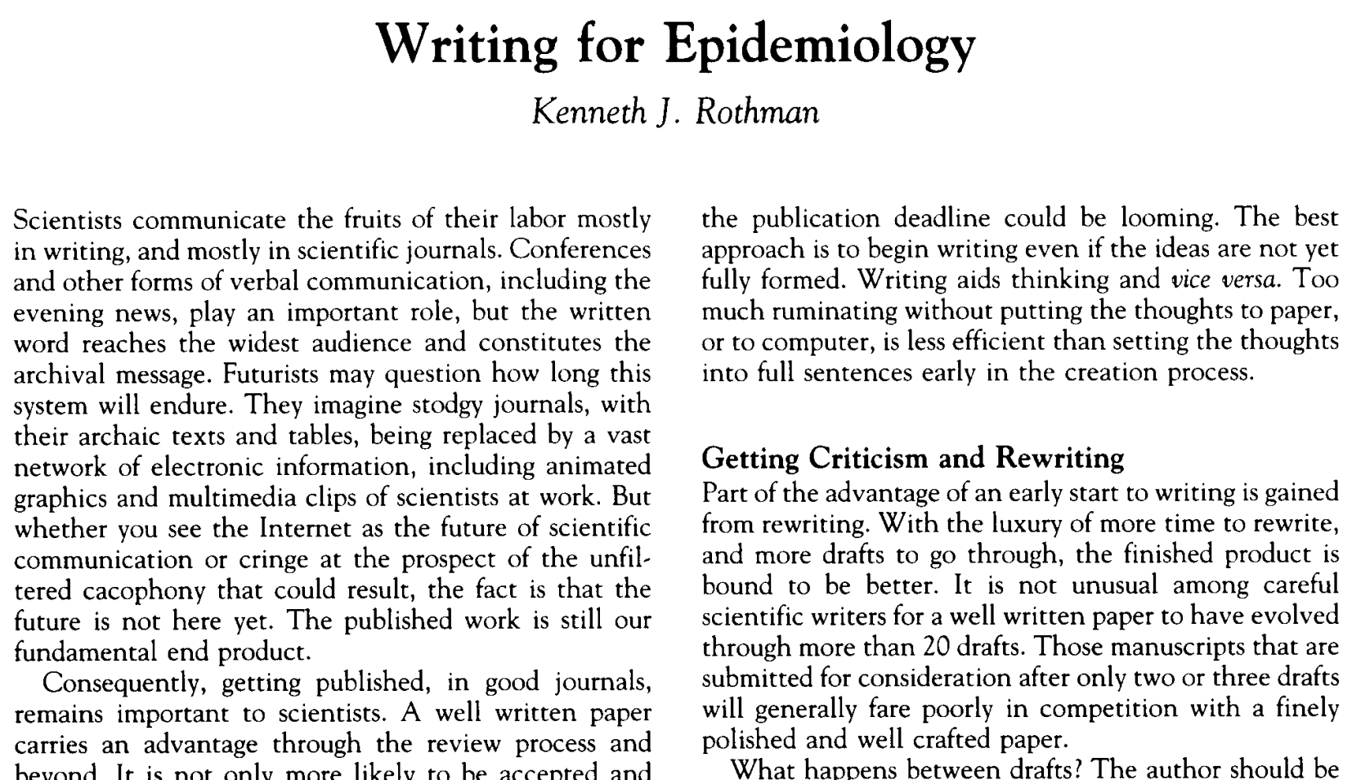

Slide 15


Slide 16
Introduction
3-5 paragraphs
Funnel shape
Logical sequence of sentences withing a paragraph
Smooth transition between paragraphs (start of a paragraph should be related to end of previous paragraph)
Should explain
General background
Specifics
Previous studies
Gaps/limitations of previous studies
Theoretical aspects (causal mechanism for why the exposure may affect the outcome)
Research question/hypothesis/aims/objectives
Use connecting words like moreover, furthermore, additionally, however, etc.
May be limited by number of words based on journal

Slide 17
Writing the introduction
Broad
Theme 1
Paragraph 1: Background of problem
Known
Theme 2
Paragraph 2: Specifics of problem
Known
Theme 3
Paragraph 3: More specifics of problem
Known
Theme 4
Paragraph 4: Identify the gap in the literature
Unknown
Research question
Theme 5
Paragraph 5: Your aim
Specific

Slide 18
How to write an introduction
https://www.youtube.com/watch?v=FTC-5P1VFFU
https://www.youtube.com/watch?v=kW6Uzn-8uMI
https://www.youtube.com/watch?v=rgLINRH4XPQ&t=4498s
https://twitter.com/13adh13/status/1406664117147123715 (check this short helpful thread)

Slide 19
Writing the methods
Should be very specific and detailed
If too many words, use online appendices or cite previous studies if methods were mentioned in them
Should explain
Data source
Study design
Target population (inclusion and exclusion criteria)
Sample size calculation
Variables (exposure, outcome, and covariates)
Measurements (data collection)
Validity and reliability of measurements
Statistical analysis
Sensitivity analysis (to check how sensitive results are to your study assumptions)

Slide 20
Writing the results
Start with population characteristics
Avoid presenting same results in tables/figures and text
Avoid interpretation of findings here (should be in discussion)
Should have
Baseline characteristics
Crude and adjusted measures of associations
Sensitivity analyses
Based on the order of your methods
Avoid table 2 fallacy (interpreting measures of associations of confounding variables in a model as causal effects)

Slide 21
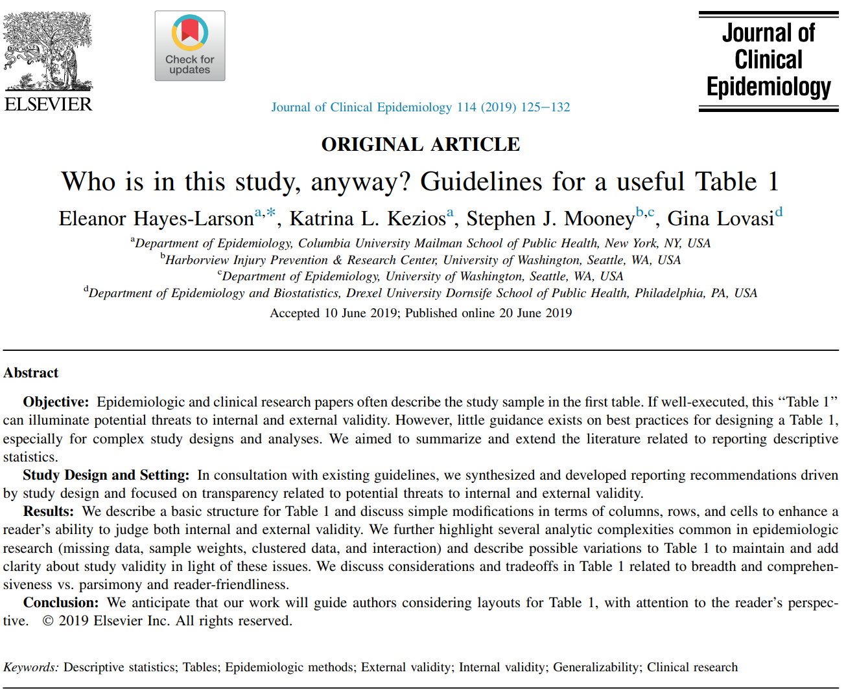

Slide 22
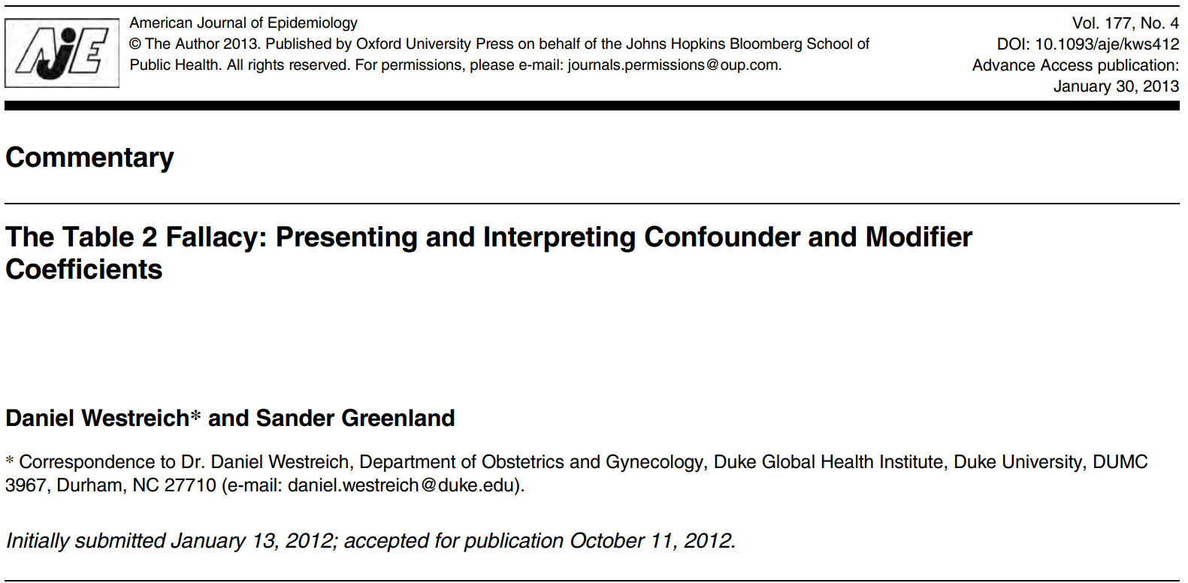

Slide 23
Writing the discussion
Begin with summary of major findings
Discuss major findings and compare to previous studies
Explain why they were different
Limitations
Avoid mentioning strengths
Avoid mentioning more research is needed
Avoid giving recommendations based on the findings of your paper (a single paper)
This need a body of literature (more than one study)
You can discuss the implications of your research though only if supported by causal methods
Conclusion (can be a separate component depending on journal)

Slide 24

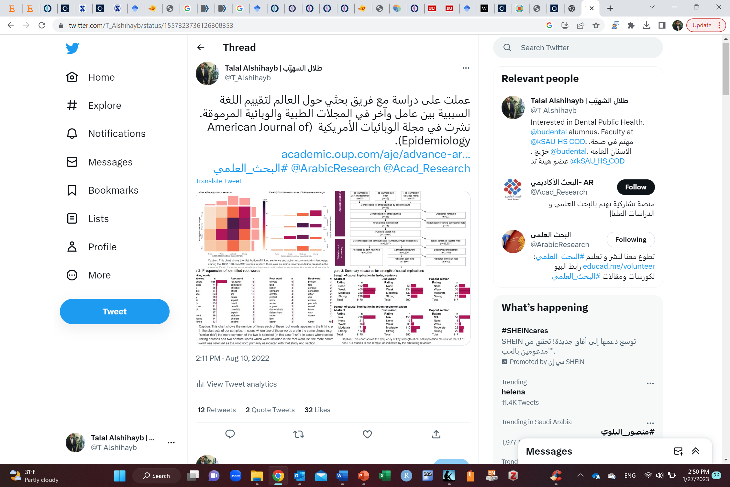
https://twitter.com/T_Alshihayb/status/1557323736126308353

Slide 25
Writing the conclusion
A paragraph summarizing the study
Can be part of discussion depending on journal

Slide 26
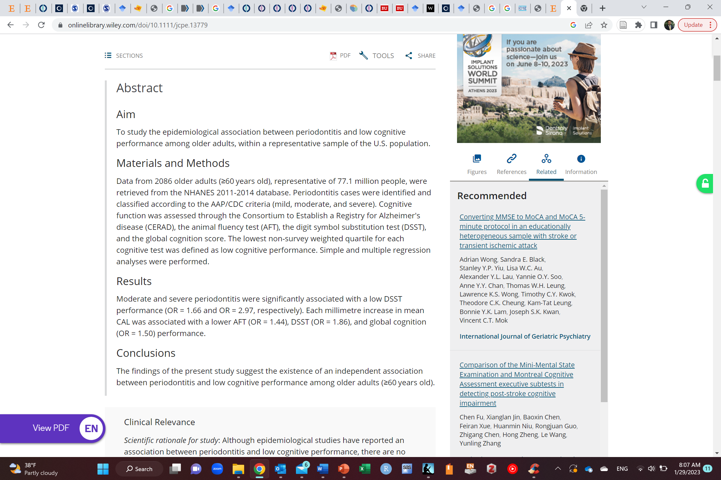
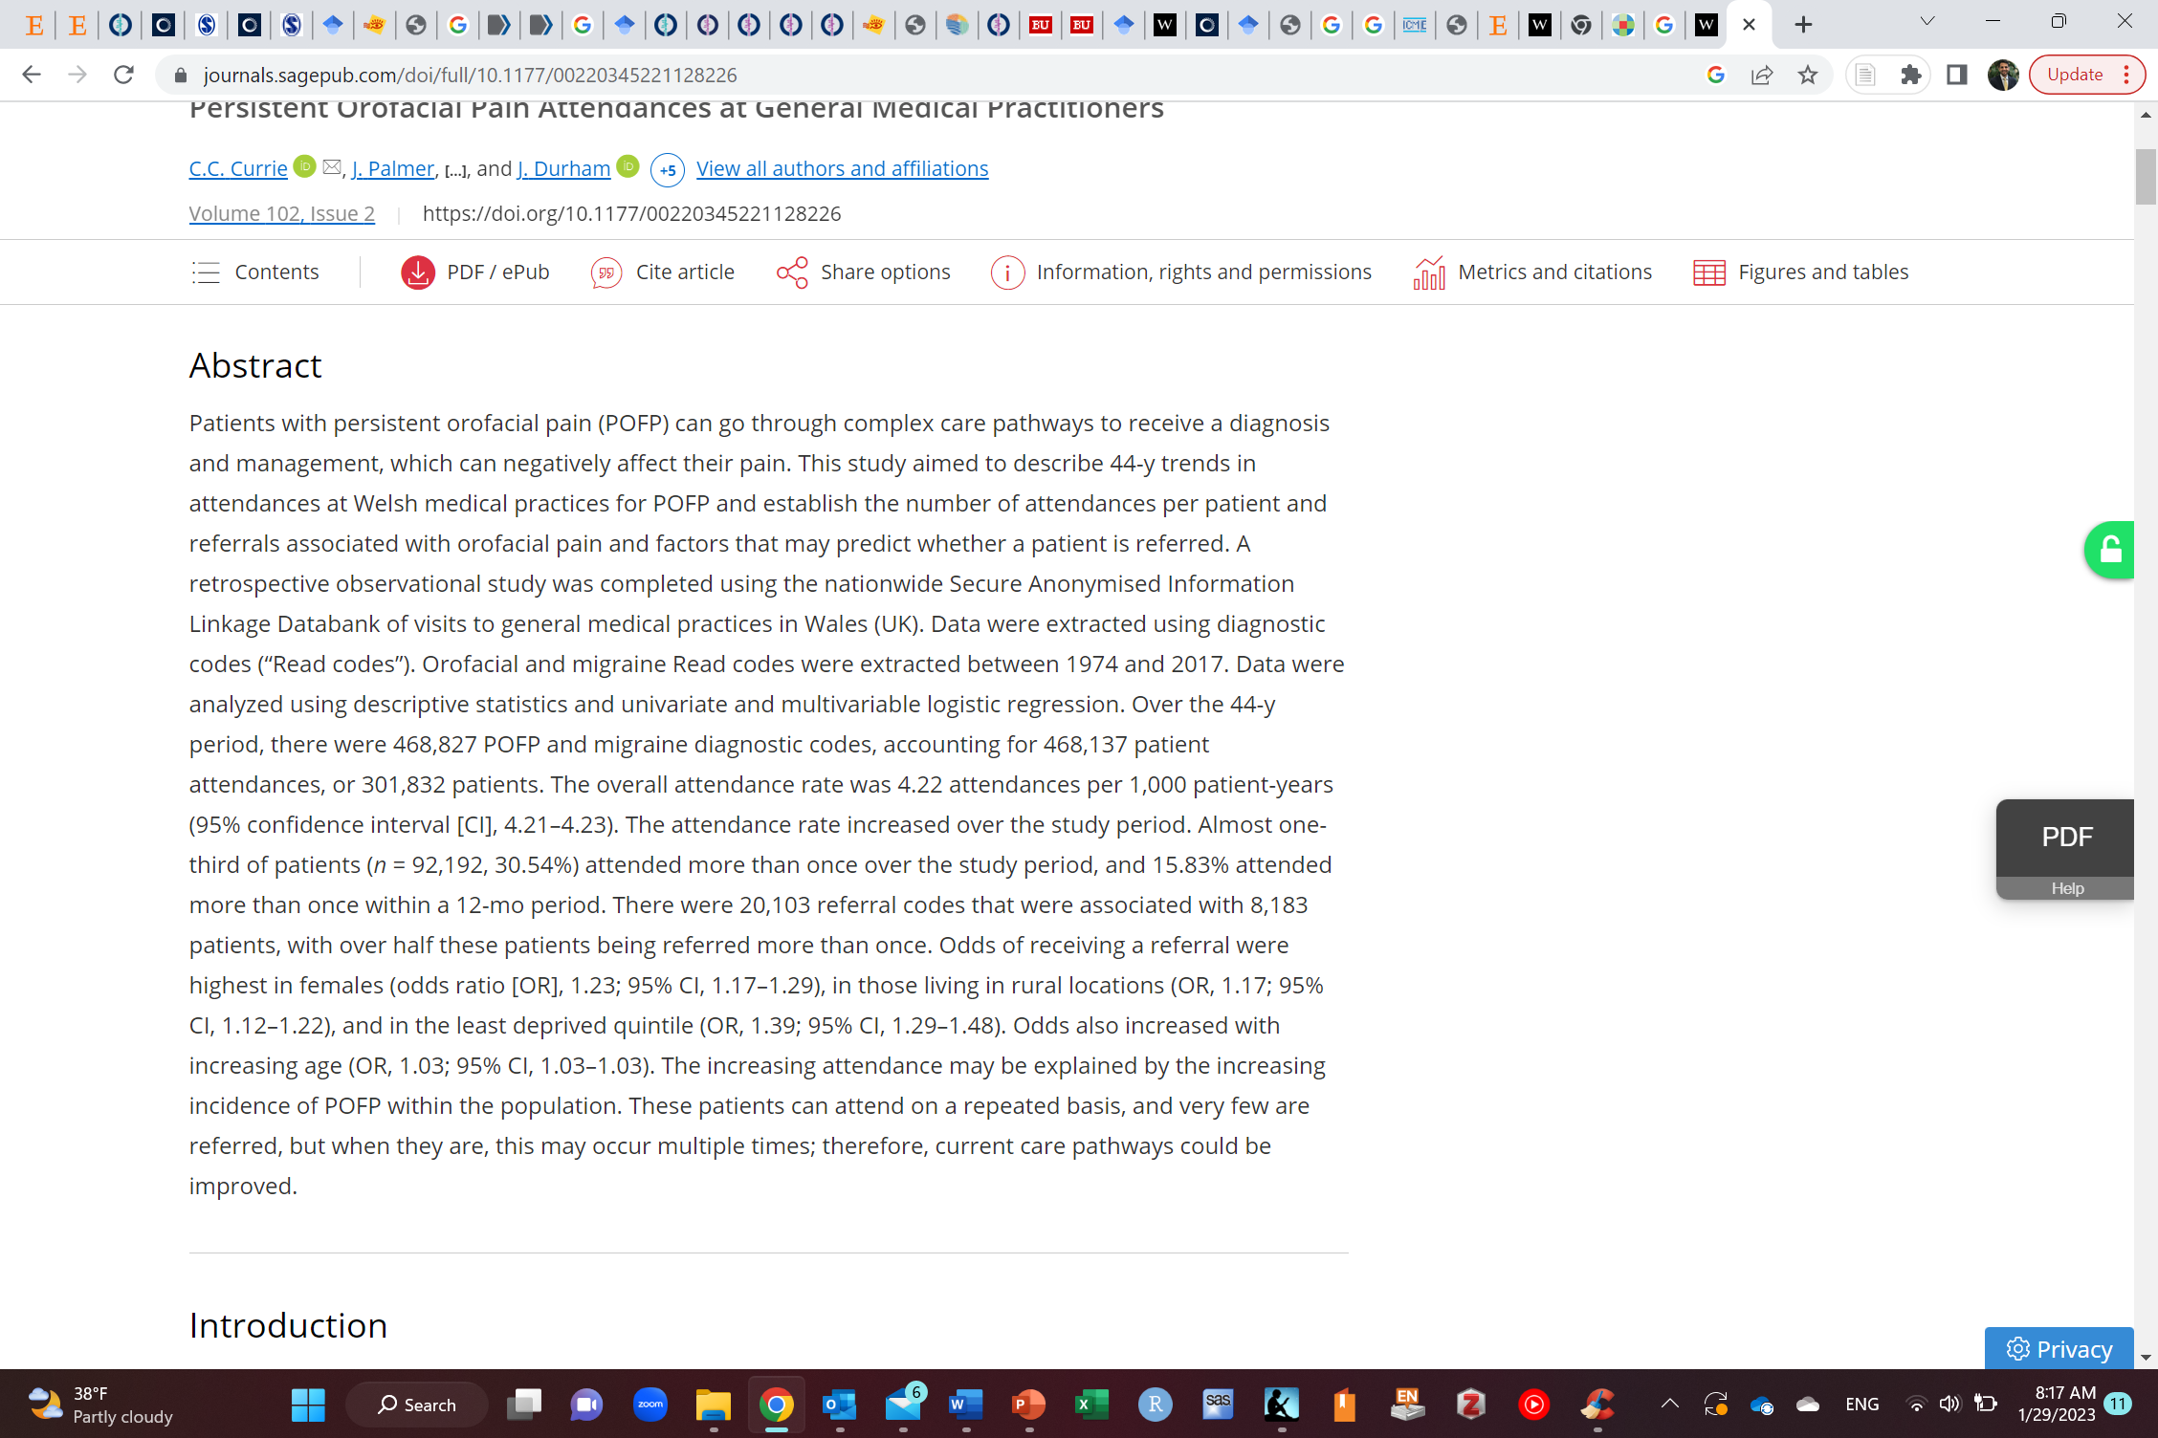
Writing the abstract
Ranges from 200-400 words depending on journal
A summary of the paper
Structured vs. unstructured
https://journals.sagepub.com/doi/full/10.1177/00220345221128226
https://onlinelibrary.wiley.com/doi/10.1111/jcpe.13779

Slide 27
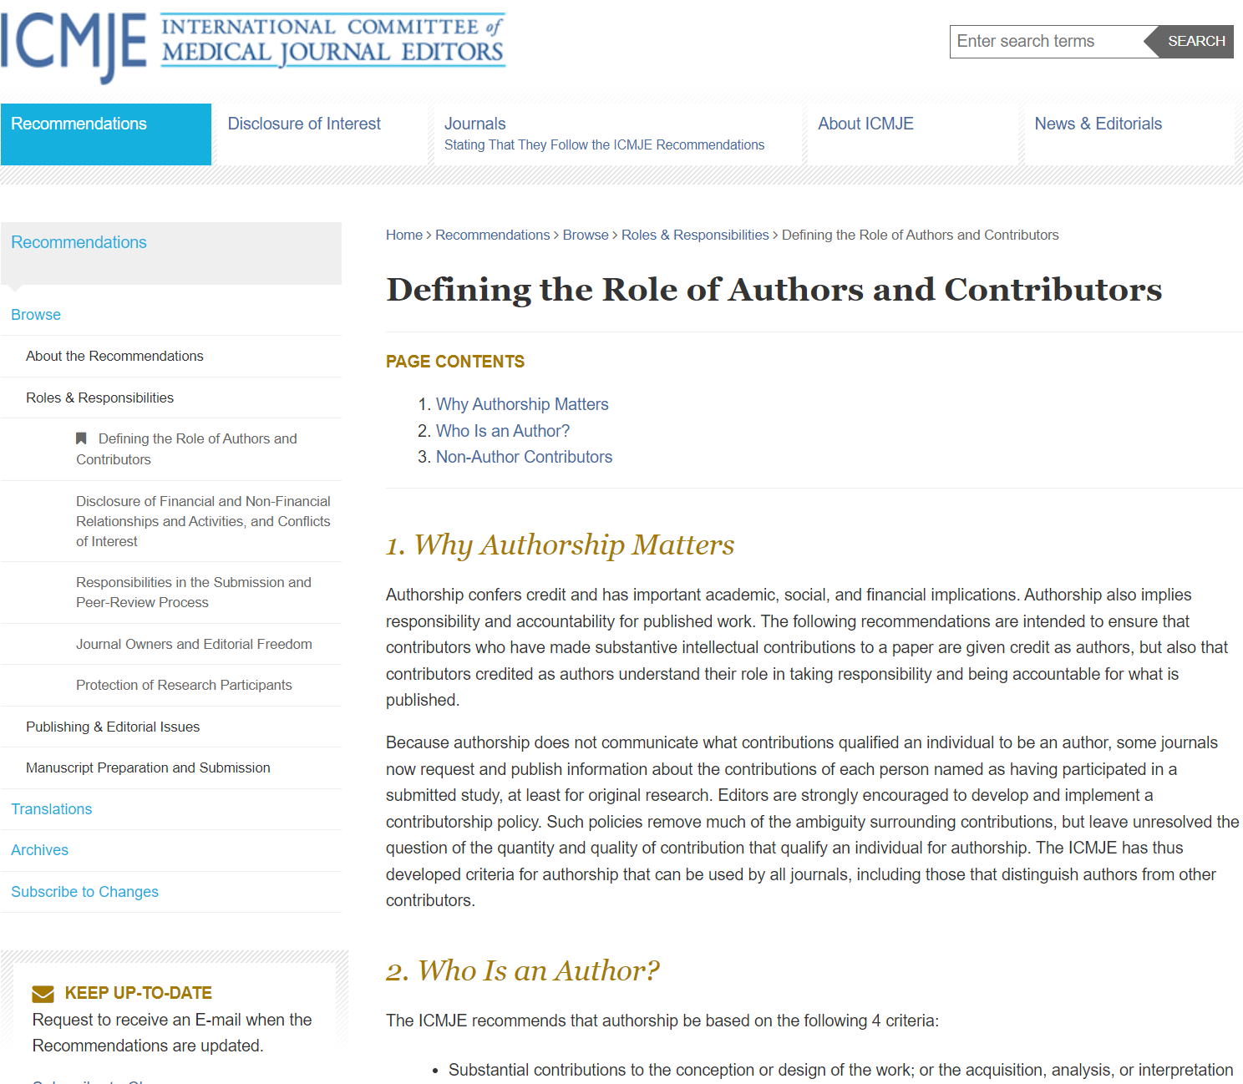
Authorship
It is not yours to give
Based on merit and work
ICMJE criteria
Order based on amount of work
First author does the major work
Last author usually a senior author
Avoid gifted authorship
Avoid gifted affiliations
Agree on things from the start

Slide 28

Journals requirements
Each journal has its own limits and how the manuscript is structured
Check the author guidelines for each paper

Slide 29
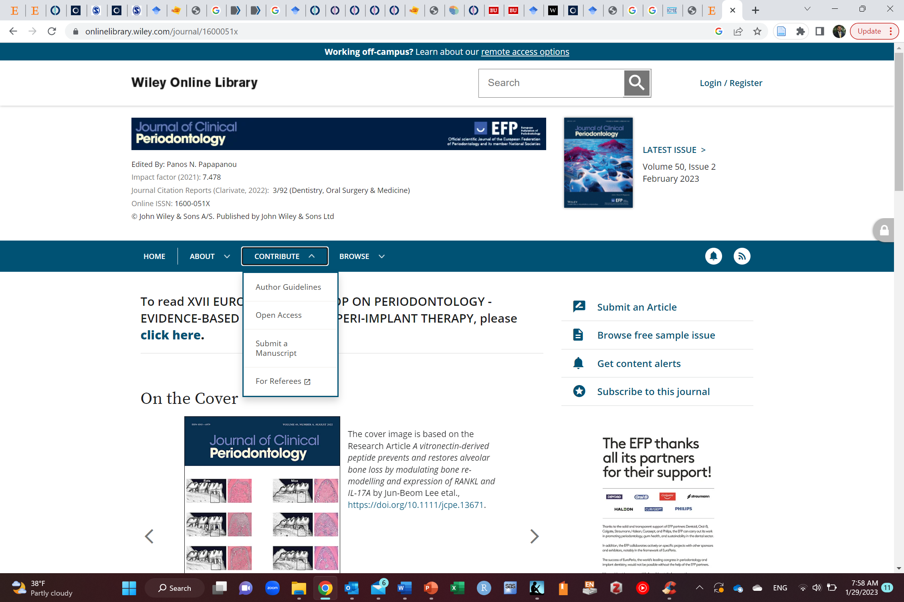
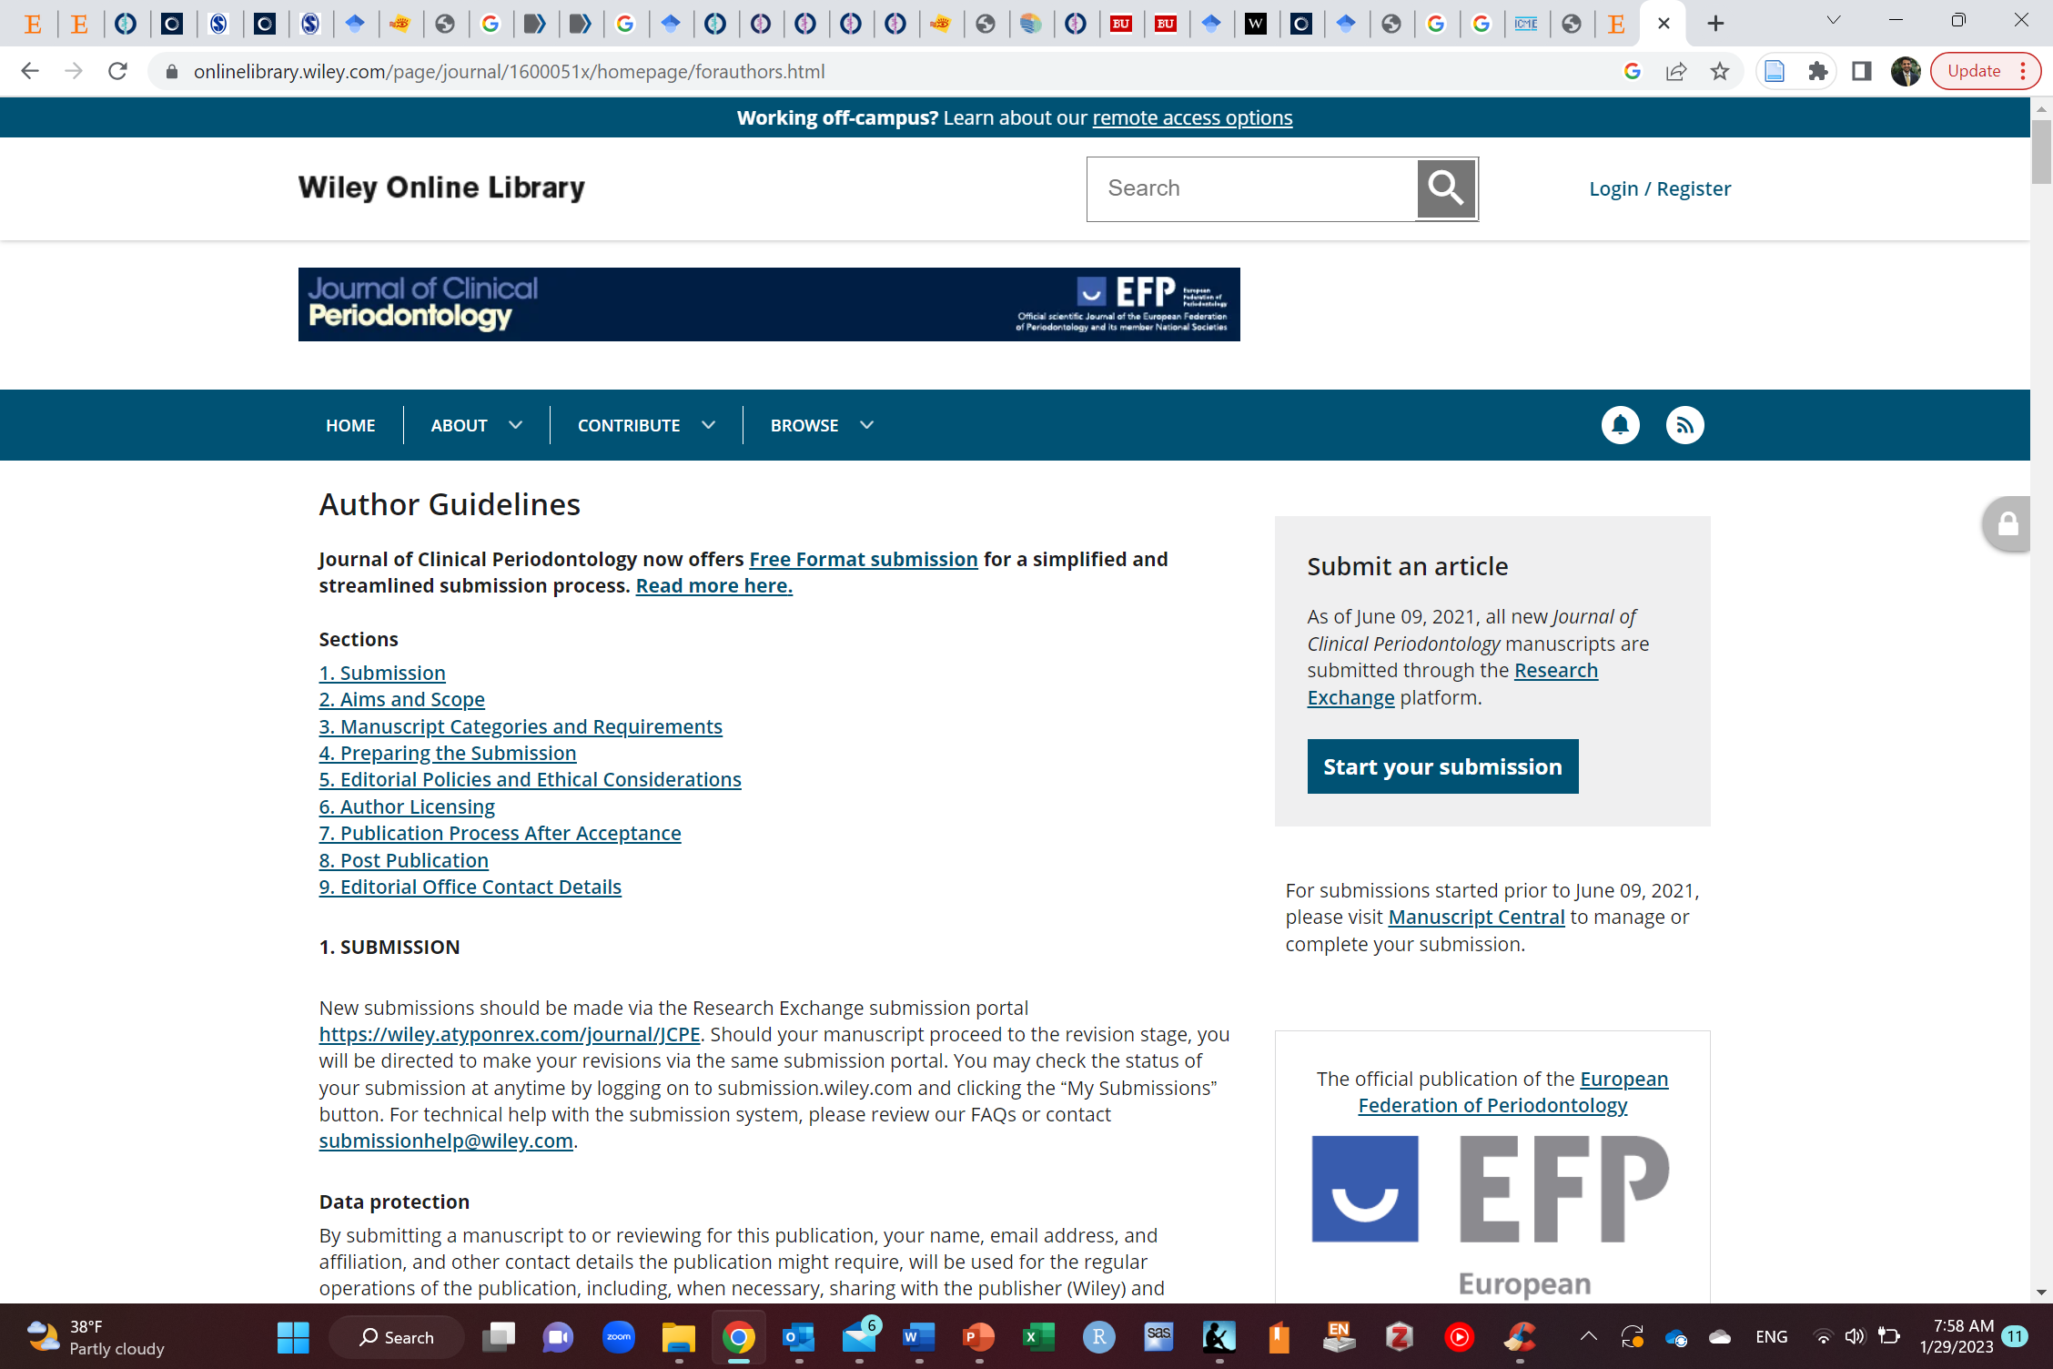

Slide 30
Tips when writing
Be clear and concise
Use appropriate tense (past, present, future)
Use appropriate punctuation (, . ; : etc.)
Use active voice (e.g., Brown et al conducted a study on so and so instead of a study was conducted by Brown et al on so and so)
Use software like Grammarly

Slide 31
Plagiarism
Do not plagiarize
Copy & paste or writing exact words of another source (even with citation)
Using others’ work without citing them
Use quotation marks when using the exact words of another person and cite him/her (if the exact phrase is needed)
Paraphrase a source and cite it (https://www.scribbr.com/citing-sources/how-to-paraphrase/)
Writing other people’s words in a different way while retaining the meaning of the original sentence

Slide 32
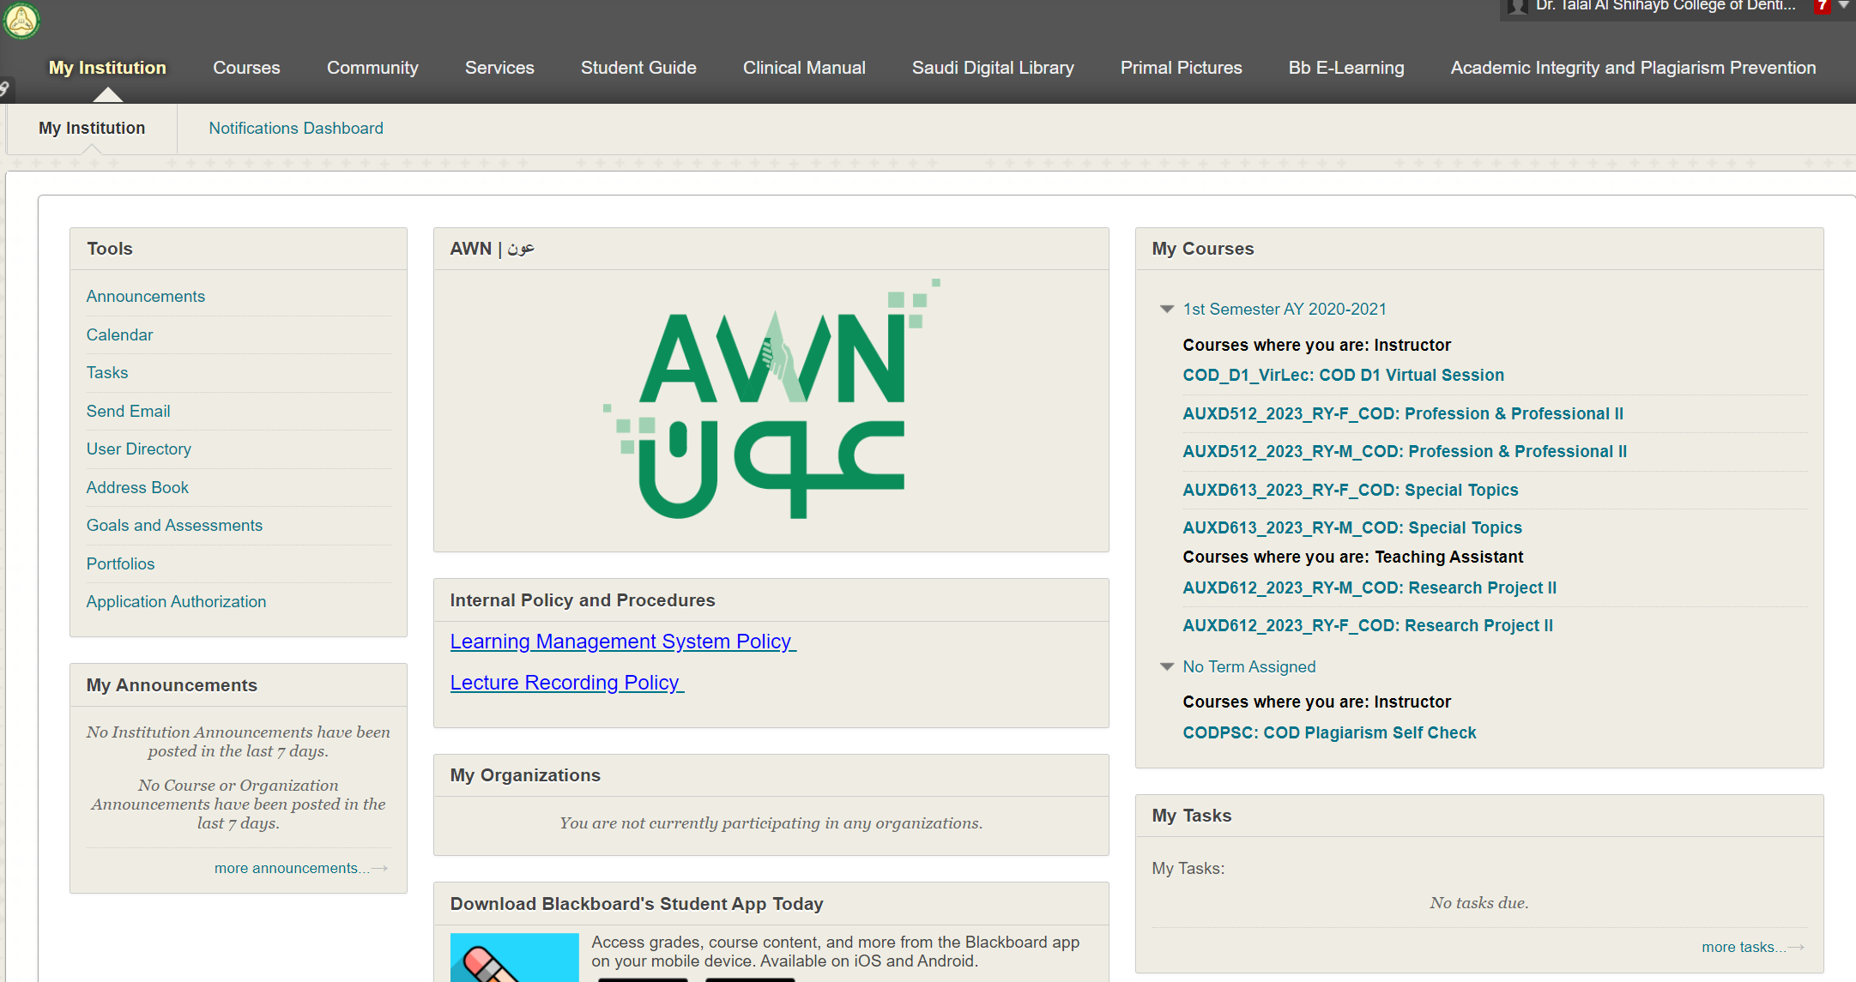
Checking plagiarism

Slide 33
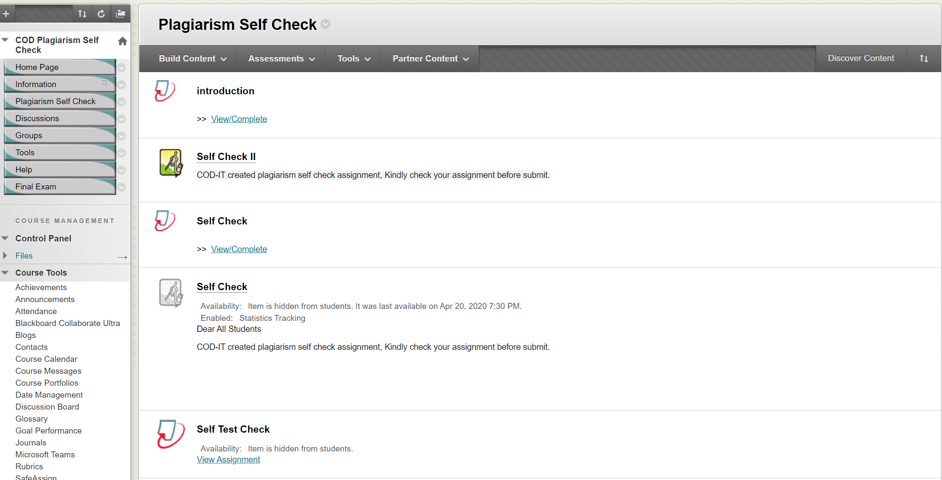
Checking plagiarism

Slide 34
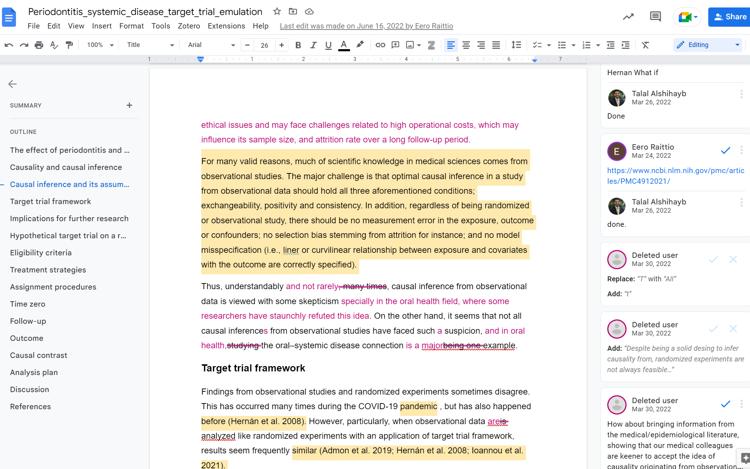
Write collaboratively
Supports Zotero

Slide 35
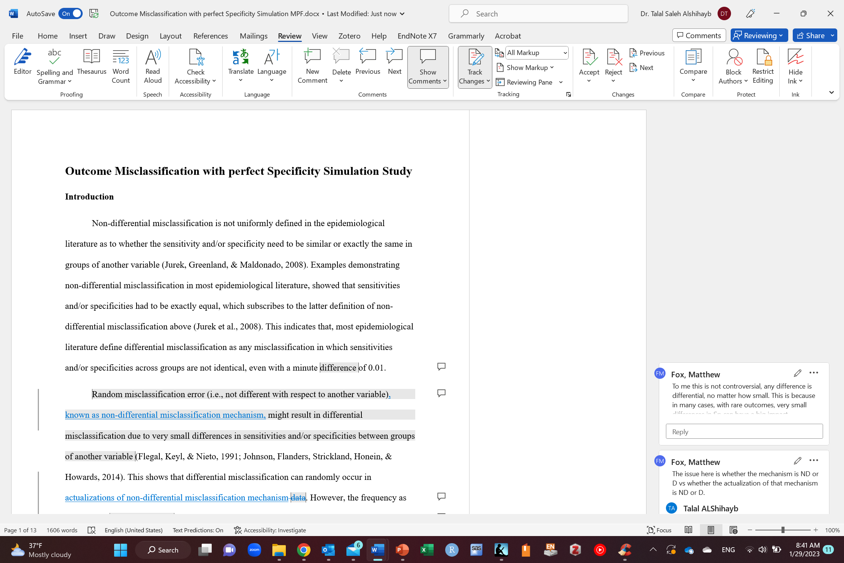
Write collaboratively
Activate track changes so that others can see what changes you made

Slide 36
Write collaboratively
Version control
Manuscipt_version_1
Manuscipt_version_2
Manuscript_v1
Manuscript_v2
YYYY_MM_DD_manuscript (2023_01_29_manuscript)
YYYY_MM_DD_manuscript_v1 (2023_01_29_manuscript_v1)

Slide 37
Take home message
Know your audience before you write
Select the journal before you write
Know the guidelines of the journal
Start writing early
Be clear and concise
Use appropriate grammar
Do not plagiarize
Use Grammarly
Read The Elements of Style by William Strunk Jr
Be critical of your writing
Take feedback from others
Practice a lot
Read more papers to write better

Slide 38
Any Questions?
shihaybt@ksau-hs.edu.sa

